Slide 1
Learning in Online Courses
4 Major Problems and How to Solve Them

Slide 2
Problem 1
You Have to Motivate Yourself
When you’re studying from home, you receive less instruction on how to use your time to complete school-related tasks. You also won’t have the external motivation that can come with the daily process of having to turn your assignments in to your teacher. These changes may make it difficult to feel motivated to take care of school responsibilities when there are so many other things you could be doing.
Since the choice to take care of school stuff will be up to you now, remembering the goals you’ve set for yourself may help you feel motivated to get up and get going with your schoolwork. Creating a vision board with your academic goals or writing them on the front of your planner can help to keep you motivated in those moments when you’d rather hit snooze than study. Assembling pictures of your future college, your career, and even your life goals can help you keep your eyes on the prize.
You can also consider finding an accountability partner that checks in with you to make sure you’re doing your work. Make a deal to keep each other accountable to getting up by starting on your school work at the same time every day, and you can send each other updates on how your studying is going. Keeping these connections can also help you remember that your friends are figuring out how to navigate learning-from-home too, and that while you may be apart, you aren’t alone.

Slide 3
Problem 2
Using Technology Can Interrupt Your Schedule
While your schedule will look different depending on your family and your needs, we recommend trying to schedule your tech time for the same slot every day. Doing so will help you keep a stable schedule and get more work done.
But what about the periods of time that you don’t have access to a digital device/ Internet? Your “unplugged” time is a great opportunity to do any studying that doesn’t require technology. If you have print copies of textbooks, study guides, quizzes or tests, or have physical projects to complete, try to work on those during your offline time.
Be patient! New learning platforms take time to gain familiarity.
Most importantly, if access to technology is an issue for you, communicate with your teacher about your situation and ask for help when you need it.

Slide 4

Make an effort to limit your distractions while you're studying. (Don't be like Doug. Or maybe...aspire to be like a less distracted, more focused Doug.)

Slide 5
Problem 3
There are a Lot of Distractions
We’re all living in slightly organized chaos under the conditions of COVID-19, and for most of us, all that chaos is compressed into the spaces of our homes as we practice social distancing. Whether your distractions are caring for your siblings, your mom’s hourly conference calls on speaker phone, or your cozy bed, distractions while trying to get school work done are inevitable.
Having a plan in place for how you’ll eliminate distractions during your scheduled study times can help you manage your time well and maximize the time you do spend studying. When you sit down to study, put your phone in airplane mode or silence notifications. If you’re tempted to stay in bed, study in the kitchen or living room. And if you can’t handle lots of noise, get out your headphones, shut your door, or study outside (if possible!).
If your home is mostly shared spaces, try negotiating with your siblings or parents for solo use of an area for an hour or so, then switch off with them. When you do have the chance for some low-distraction study time, complete the school-related tasks that require the most concentration first, and save your lower-pressure assignments for times when the distractions aren’t unavoidable.

Slide 6
Problem 4
Studying Can Get Monotonous or Boring
It may not seem like it at first, but doing school from home might get a little tedious after a while. When you go to school, you have more opportunities to use different learning styles and mediums, attend classes that incorporate physical activity, and spend time with your friends and peers.
When you’re doing school from home, a lot of these elements of learning that you get to experience while at school mostly disappear. You’ll be able to use technology to listen to lectures and engage with other multimedia course content, but there are some things about face-to-face, in-person learning that is difficult to recreate through digital mediums.
If the absence of some of these aspects of learning makes you feel a little bored or disengaged right now, make an effort to connect with your classmates and to get creative with your learning each day. Doing school from home shouldn’t exclusively consist of you staring at a computer screen, and it shouldn’t just be hours of independent study time either. Balance is key! Even though you may feel pressure to dedicate your entire “school day” to completing assignments online, remember that a real day at your school isn’t actually structured that way.
To mix things up, spend some of your day being active. Draw something or color a picture. FaceTime your friends and talk through a study guide. You can even spend some time outside (if you can social distance, of course)! Finding creative ways to incorporate these elements of learning into your long days of school-from-home can help to alleviate some of the boredom you might be feeling.

Slide 7


Slide 8
Assignment #5
Using all of the information and assignments you have completed this week, create a daily schedule that works for you for remote learning.

Slide 9
Why do you need a schedule?
1. A schedule will provide the structure needed to reduce anxiety.
2. A virtual learning schedule will be different than a regular school schedule.
3. Schedule should include breaks, snacks, lunch, and exercise.
4. In addition to on screen time, effective on-line learning needs time away from the screen for students to practice, create, read, and explore assignments.
5. While having a clear but flexible structure for your at-home school days is important, it is also crucial to adjust your expectations for what you can get done while learning on-line.
6. Set clear boundaries between time that is meant for relaxing and leisure and time that is meant for learning. (No Netflix during study time!)

Slide 10
7. Your needs are different than other students, so your schedule needs to fit your unique learning situation.
8. To avoid burnout, consider dedicating uninterrupted time in the morning and time in the afternoon for studying.
9. Allow time to take care of other responsibilities in your life.
10. You may need to revise your schedule to suit the realities of your life at any given time and remember to be adaptable and flexible.

Slide 11
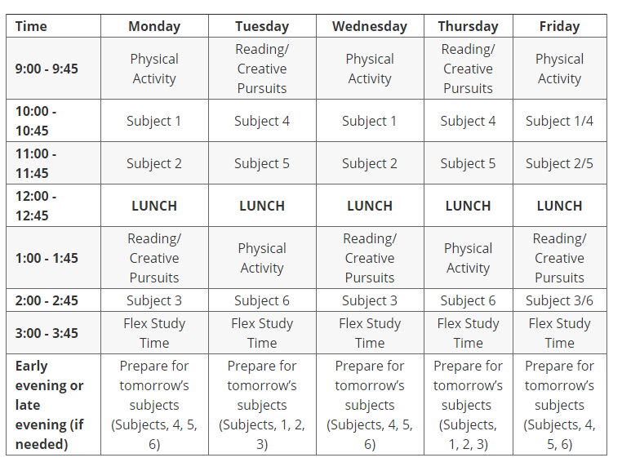
Sample Schedule
Sample Schedule

Slide 12
Reminder
All the assignments you have completed this week need to be uploaded in each of your teachers Google Classrooms.
Remember- ask your teacher if you need help!!!

